Slide 1
IIOT GE Healthcare Manufacturing – Machine Data Processing
Valter Pinho
Manufacturing Analytics Technical Product Manager

Slide 2
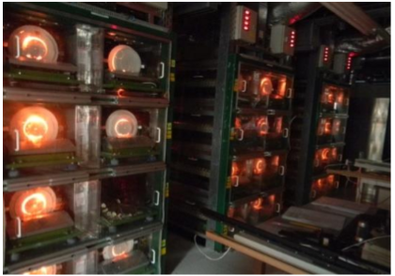
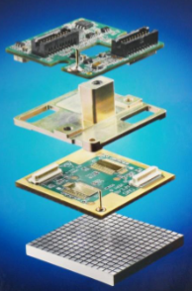
Business Case

Slide 3
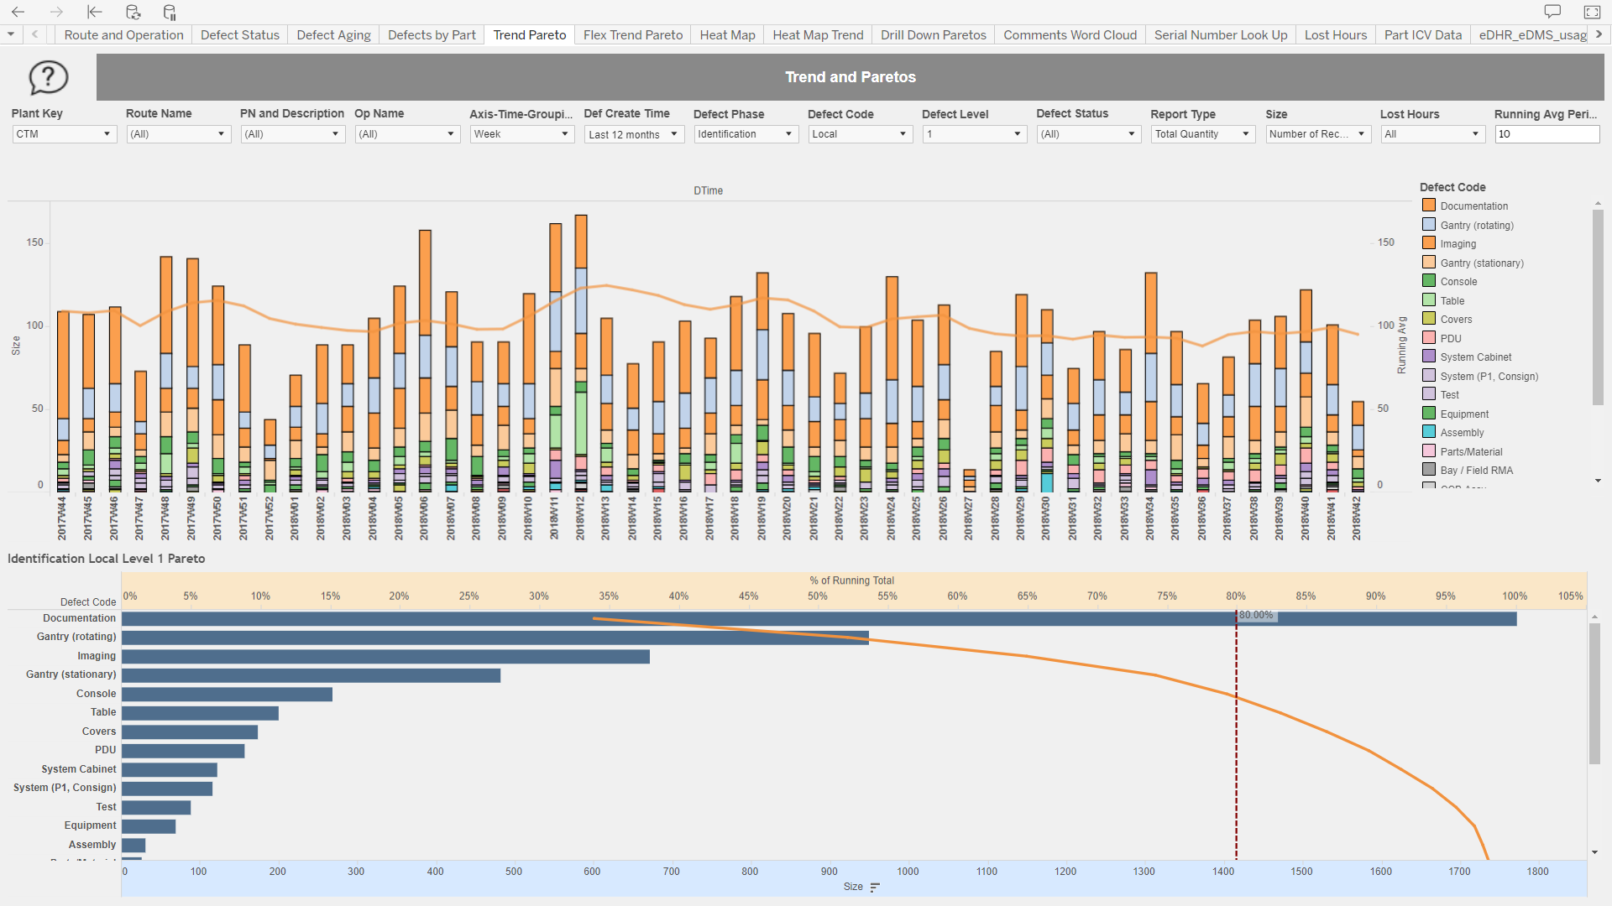
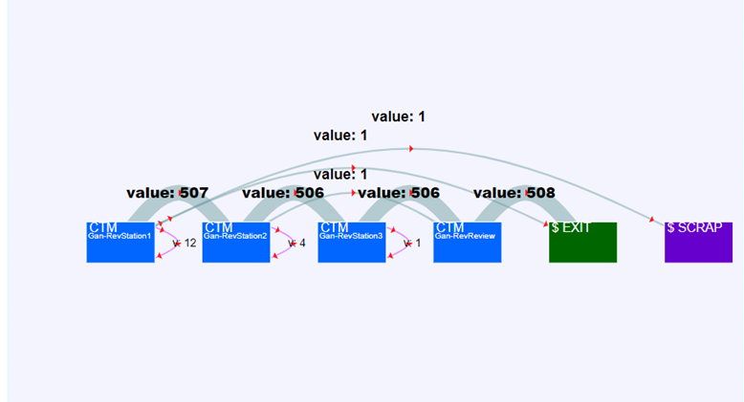
MES Based Reports
Yield & DPU Reports
Route & Operation Level
Defect Reports
Trends, Pareto, Heat Map, other
Data Collection Plan (DCP) Reports
Route and Operation Level DPMO Trend
DCP Pass/Failure Trend
Greatest Change DCP Line
Raw Data Extract
DCP Statistical Analysis
Z-score
I-MR & X bar-S Control Charts
Before & After 2 sample t-test
Part Consumption Reports
Part Replacement rates at Route, Parent and Child Level
Serial Number Genealogy Tree
Lean KPIs:
Cycle Time Estimate
Waiting Time Estimate
Operation Flow
Others:
WIP
Lead Time
PA Time Since Operation

Slide 4
High Level Architecture
MES
Machine Maintenance
Teradata
Test Data
Licensing
ERP
Web Data Connector
Labor
Machine Data
Planning

Slide 5
Tableau (Self-Service) Usage
5000+
3 - 5 days
Enable self-service
Data Queries per day | Self-service Publishers | Self-service Projects | Workbooks | Dashboards | Data Sources
10,000+ | 190+ | 80+ | 1,200+ | 3,500+ | 150+
1 day
Leverage standard content
Tableau Users

Slide 6
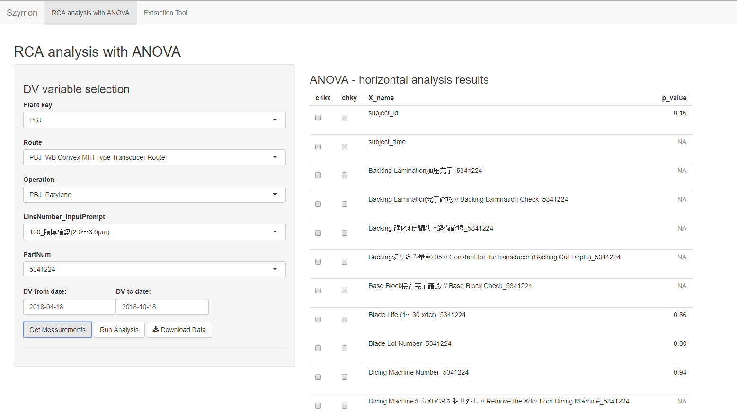
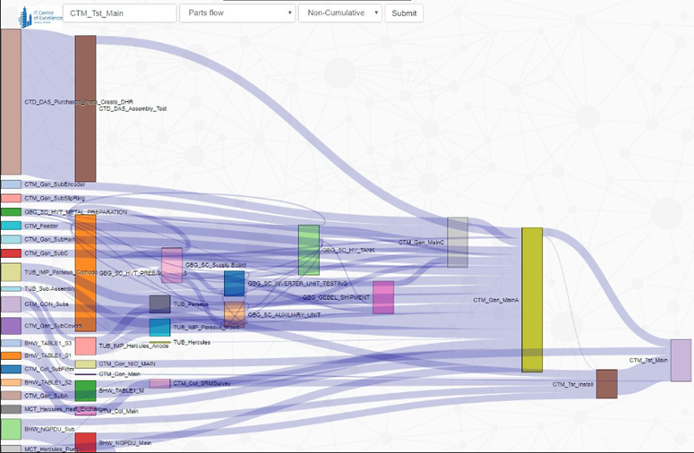
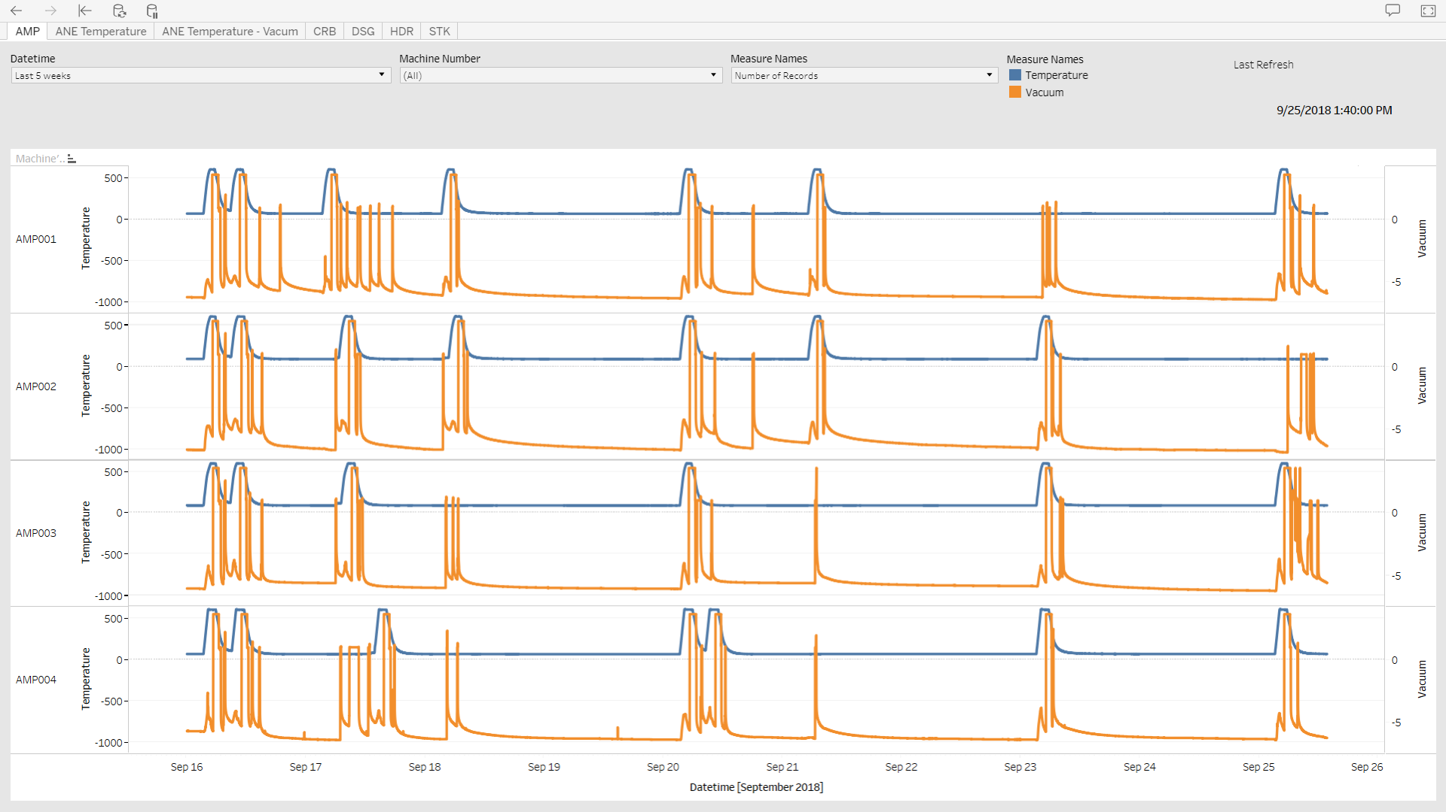
2019 Planned Capabilities
Advanced Statistical Analytics
Extract and Organize MES data for Statistical analysis
Use CTQ Specs Genealogy to use Children Part Attributes
Use MES & Test data to determine Root cause of a problem
One-Way ANOVA
Simple Regression
Logistic Regression
Chi-squared
Dimensionality Reduction
Advanced Statistics & Machine Learning
Value Stream Analytics
Value Stream KPI
DPU
Lead Time (Total & Manufacturing)
WIP
Critical Path
Process Mining to Identify:
Bottlenecks
Critical Routes & Operations
Critical Personnel
Machine Data
Visualize Parameter Performance
Compare Cycles from same recipe
Cycle Phases Descriptive Statistics (ex. Slope during ramp up,
Max, Min, etc)
Identify abnormalities & alert operator

Slide 7
High Level Architecture – Machine Data

Slide 8
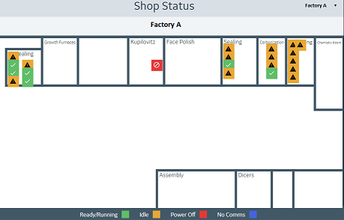
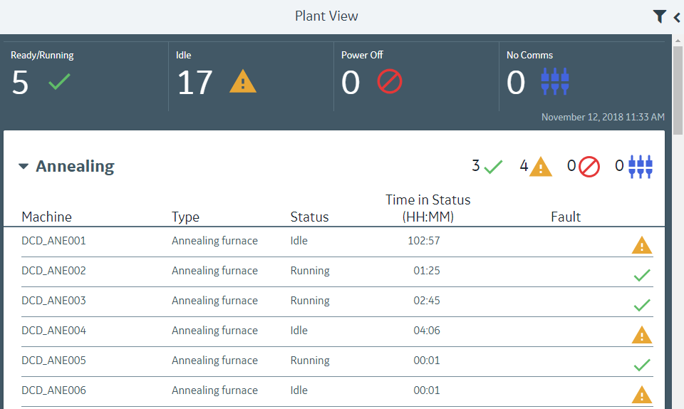
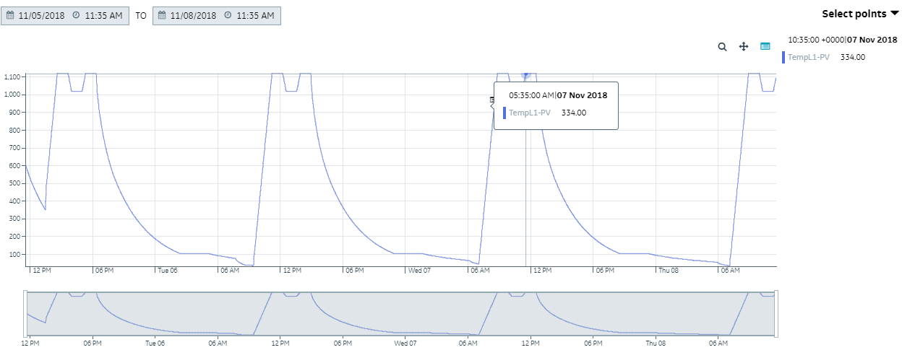
Visualize Live Data
High level Shop Floor Health Status
Status Breakdown per Process / Machine Type
Parameter Trending
Machine Utilization

Slide 9
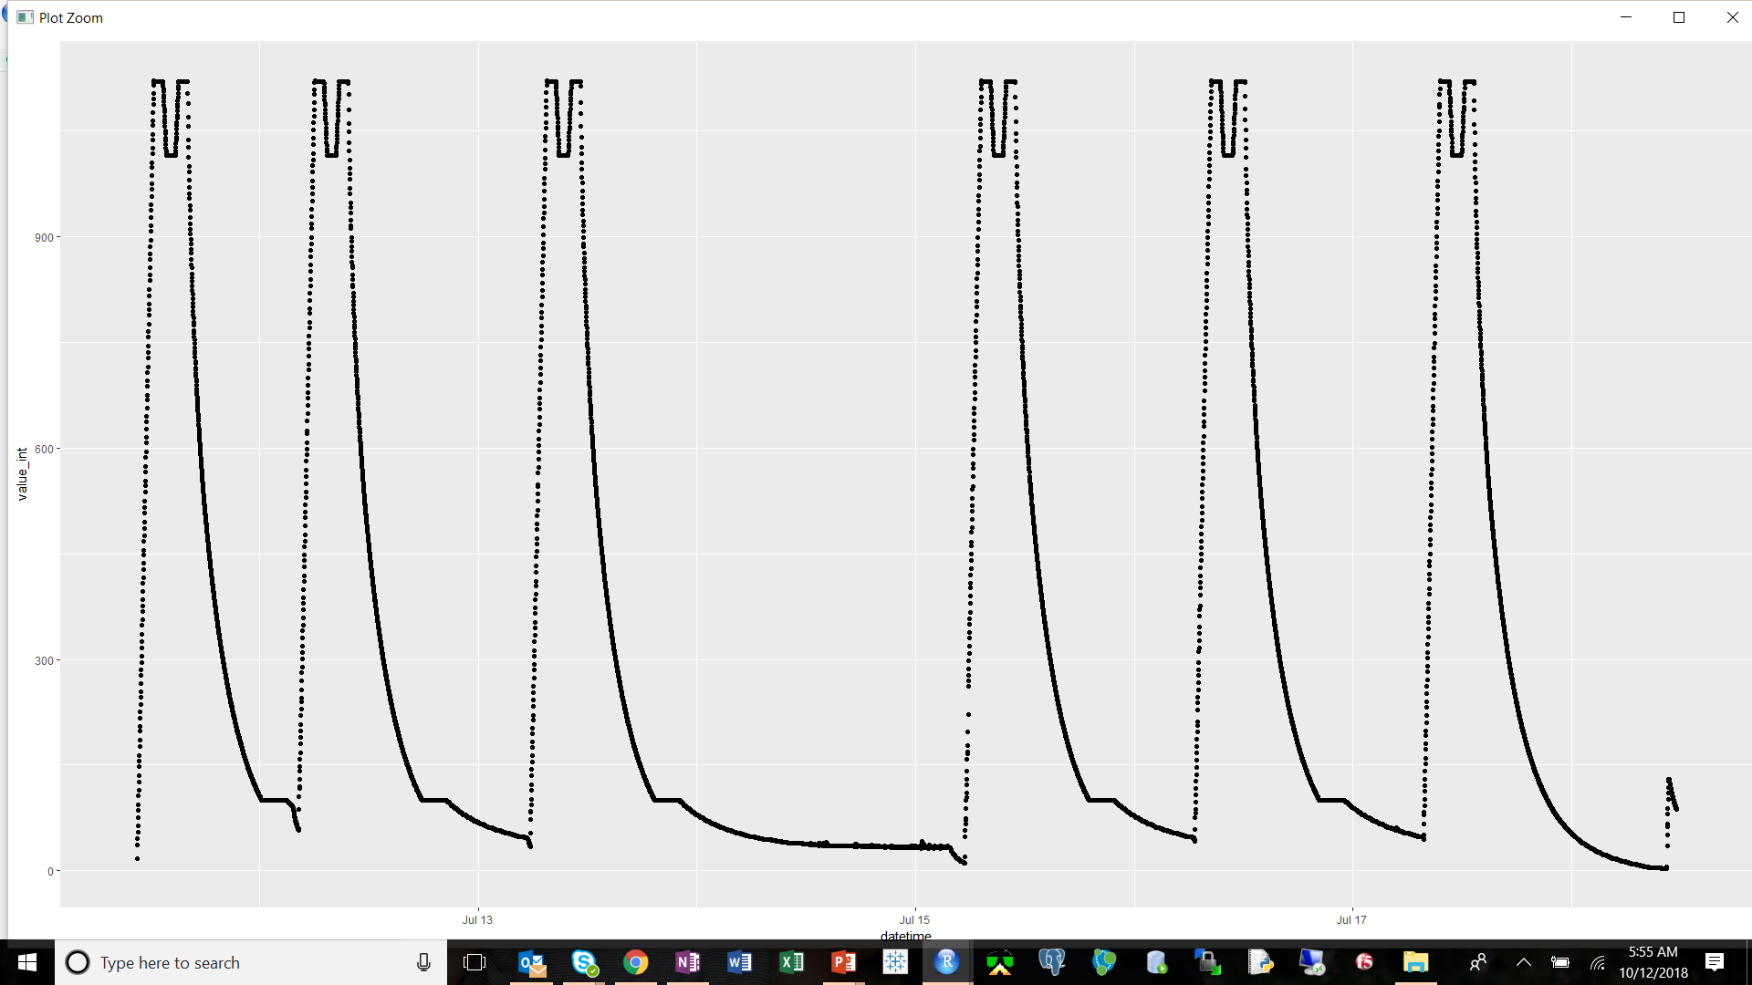
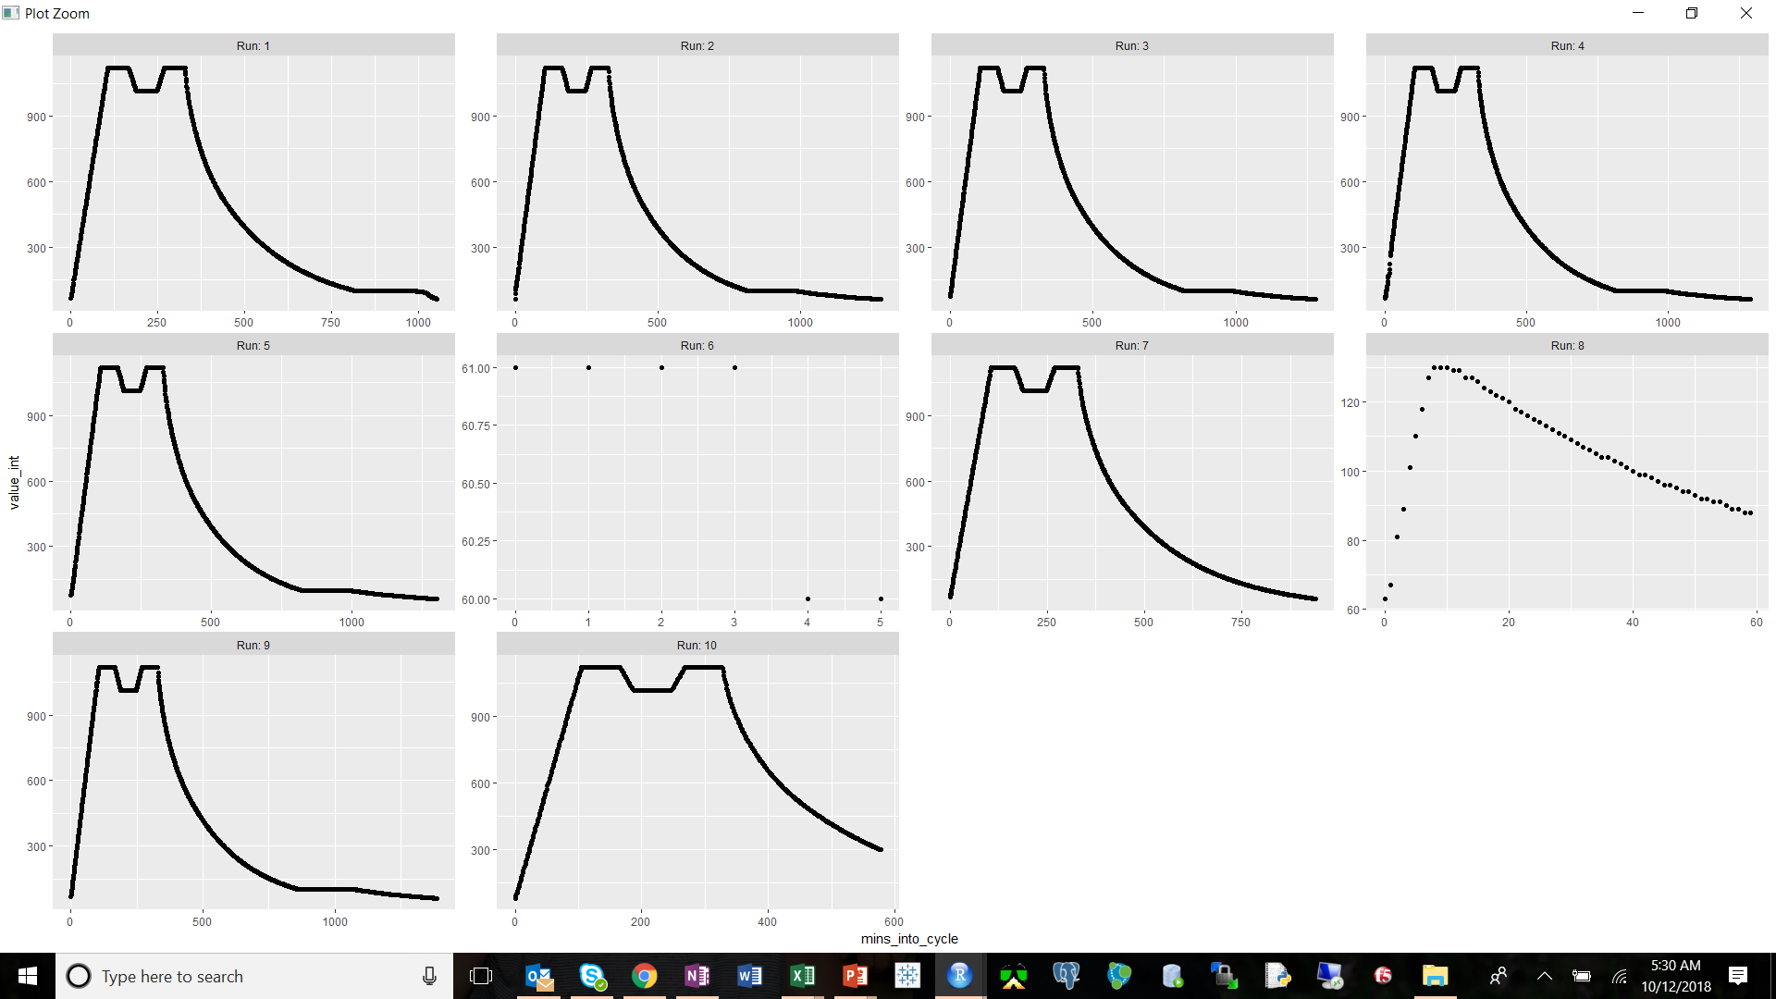
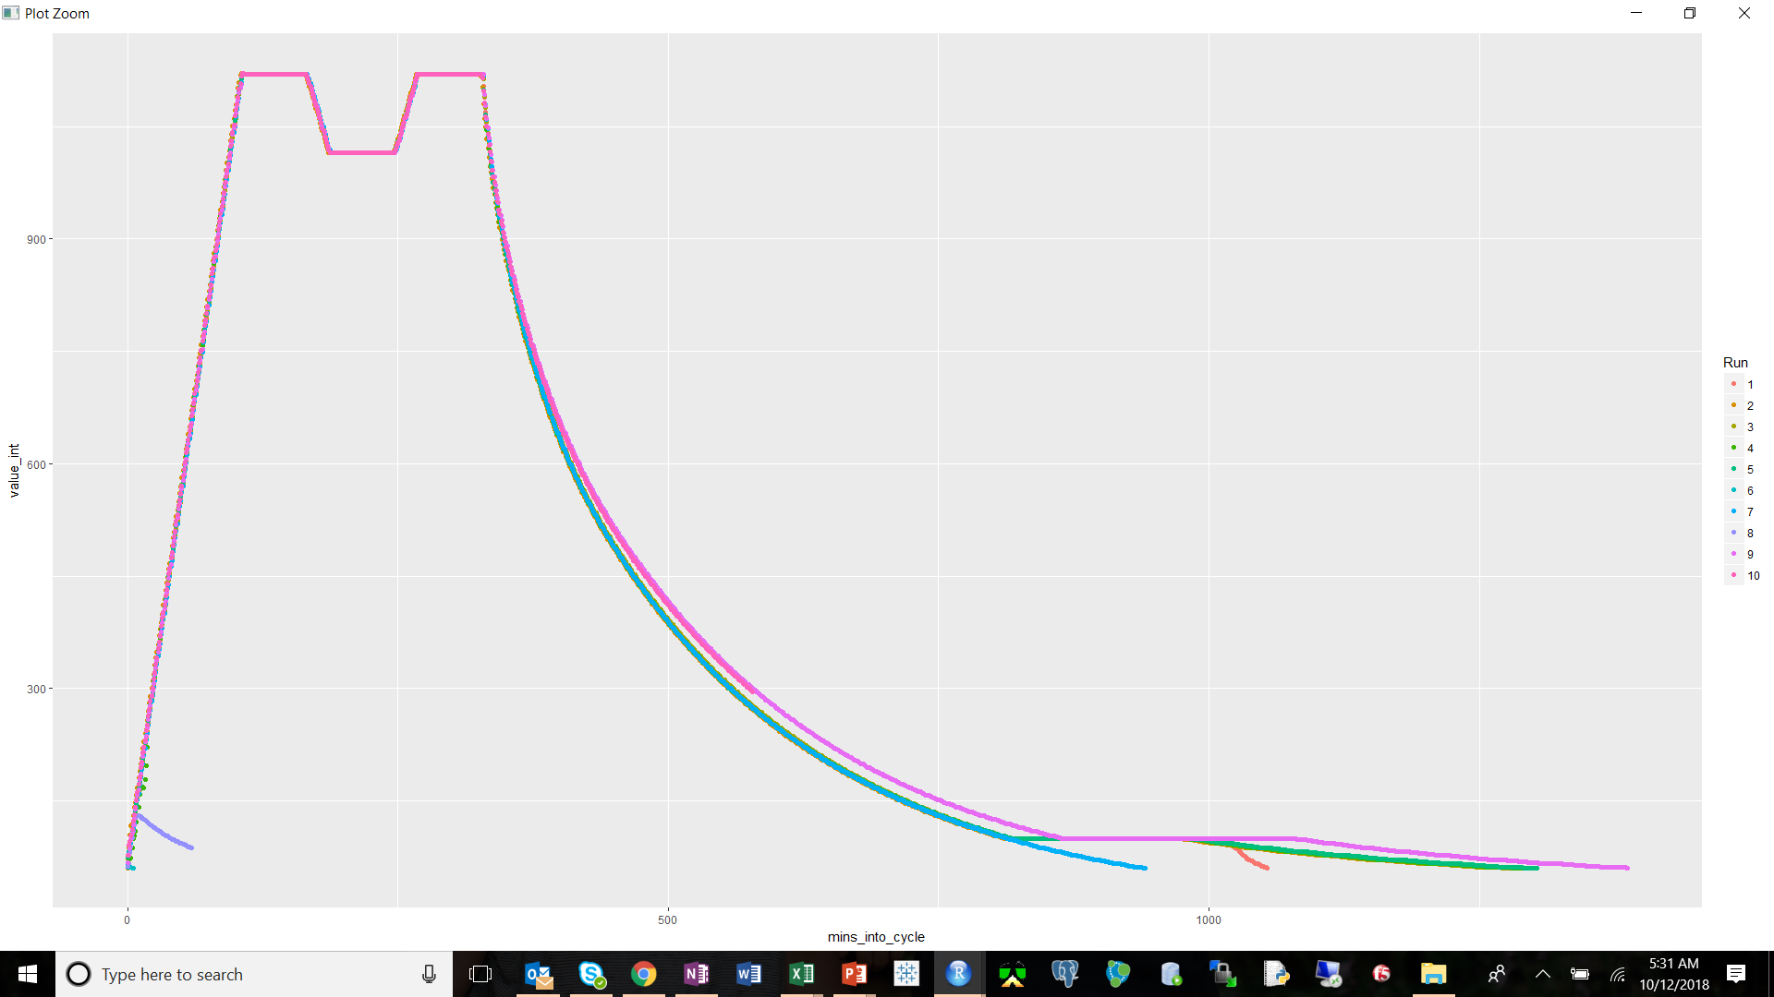
Cycle Identification

Slide 10
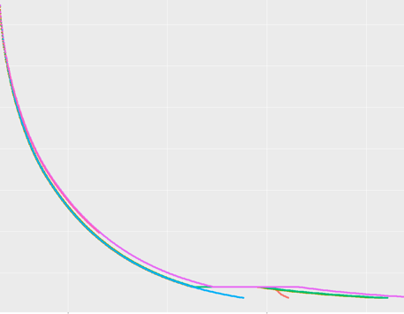
Cycle Phase Breakdown
Ramp-up
Processing
Cooldown

Slide 11
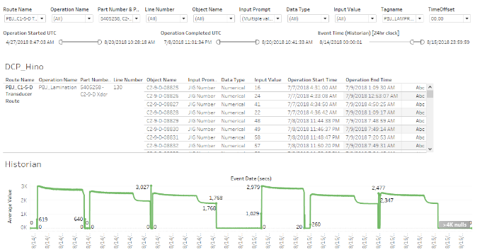
Machine and Process Data Correlation

Slide 12
Alerting For Anomalies

Slide 13
Summary
Current State:
Live data Visualization
High Level Machine Status
Machine Occupancy
Parameter Trending
Threshold based Alerting
Planned Capabilities:
Visualize Parameter Performance Historically
Compare Cycles from same recipe
Cycle Phases Descriptive Statistics (ex. Slope during ramp up,
Max, Min, etc)
Automatically identify abnormalities & alert operator
Correlate Machine to Process Data

